Slide 1
Operator Foundation
The Future of Internet Freedom
Why It Will Fail, and How We Will Save It

Slide 2
Dr. Brandon Wiley
PhD in Information Studies
Jigsaw Research Fellow
President of Operator Foundation
@blanu
OperatorFoundation.org
brandon@operatorfoundation.org

Slide 3
Dr. Brandon Wiley
Freenet
BitTorrent
Peer-to-peer
Tor
Dust

Slide 4
Operator Foundation
Operator makes usable tools
to help people around the world
with censorship, security, and privacy.

Slide 5
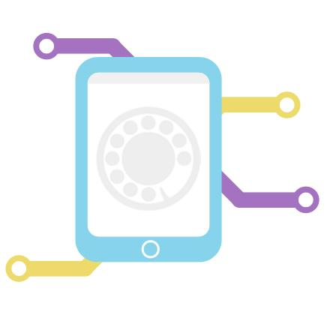
Three Pillars
technology
design
people

Slide 6
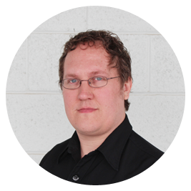
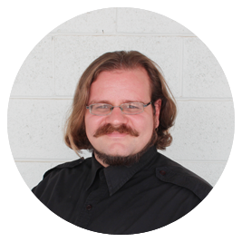
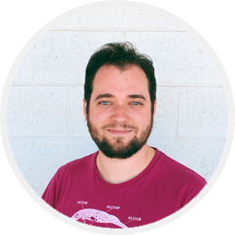
Operator Board
Brandon Wiley
Corie Johnson
Donald Jackson
Lewis Weil

Slide 7
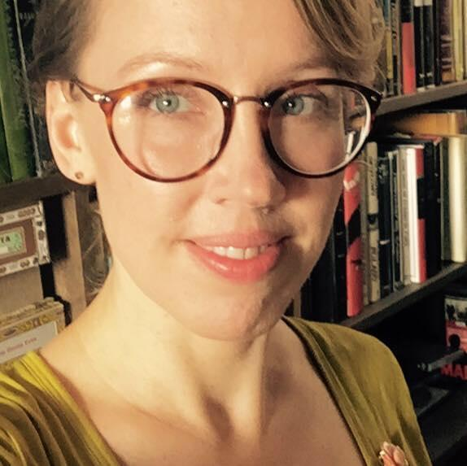
Operator Staff
Adelita Schule
Melissa Mason
NoNNot pictured:
Amber Carter
Robin Tarsiger
Lauren McCormick

Slide 8
Internet Freedom
What is it?

Slide 10
Access to credible and relevant information

Slide 11
Use Cases
Human Rights
Public Safety
Democracy
Health and Welfare
Education
Economic Prosperity
Equal Rights

Slide 12
1990s Internet Theory
A Declaration of Independence of Cyberspace
The Hacker Manifesto
The Temporary Autonomous Zone

Slide 13
1990s Internet Theory
Declaration of Independence of Cyberspace
Governments of the Industrial World, you weary giants of flesh and steel, I come from Cyberspace, the new home of Mind. On behalf of the future, I ask you of the past to leave us alone. You are not welcome among us. You have no sovereignty where we gather.
John Perry Barlow

Slide 14
1990s Internet Theory
The Hacker Manifesto
This is our world now. The world of the electron and the switch; the beauty of the baud. We exist without nationality, skin color, or religious bias.
Loyd "The Mentor" Blankenship

Slide 15
1990s Internet Theory
The Temporary Autonomous Zone
A new territory of the moment is created that is on the boundary line of established regions. Any attempt at permanence that goes beyond the moment deteriorates to a structured system.
Hakim Bey

Slide 16
Internet Freedom
Why it will fail

Slide 17
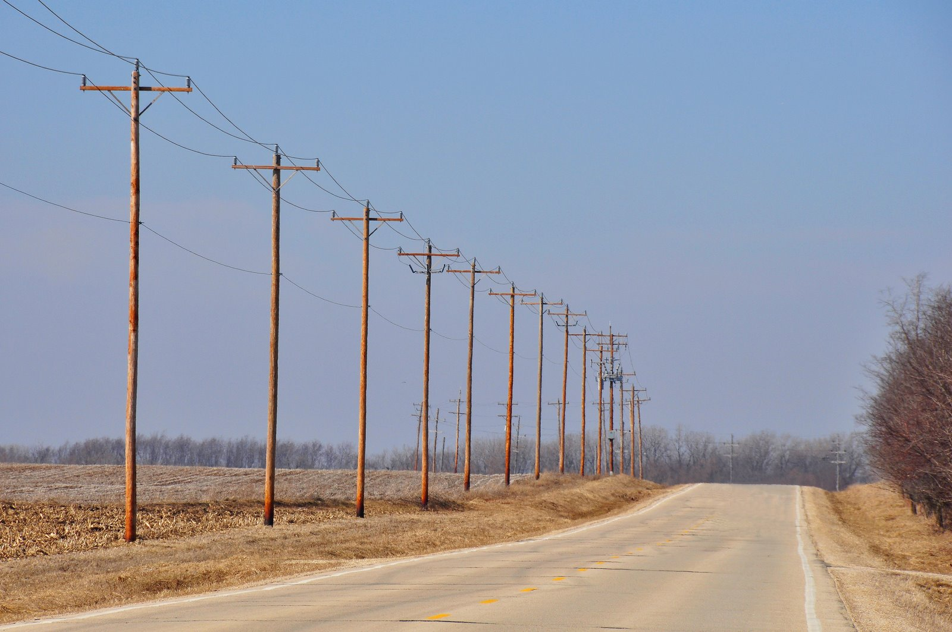
The Internet is Physical

Slide 18
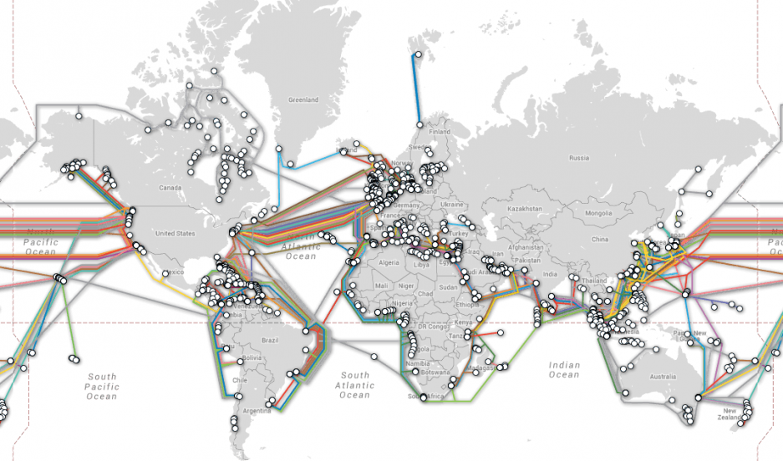
The Internet is Physical

Slide 19
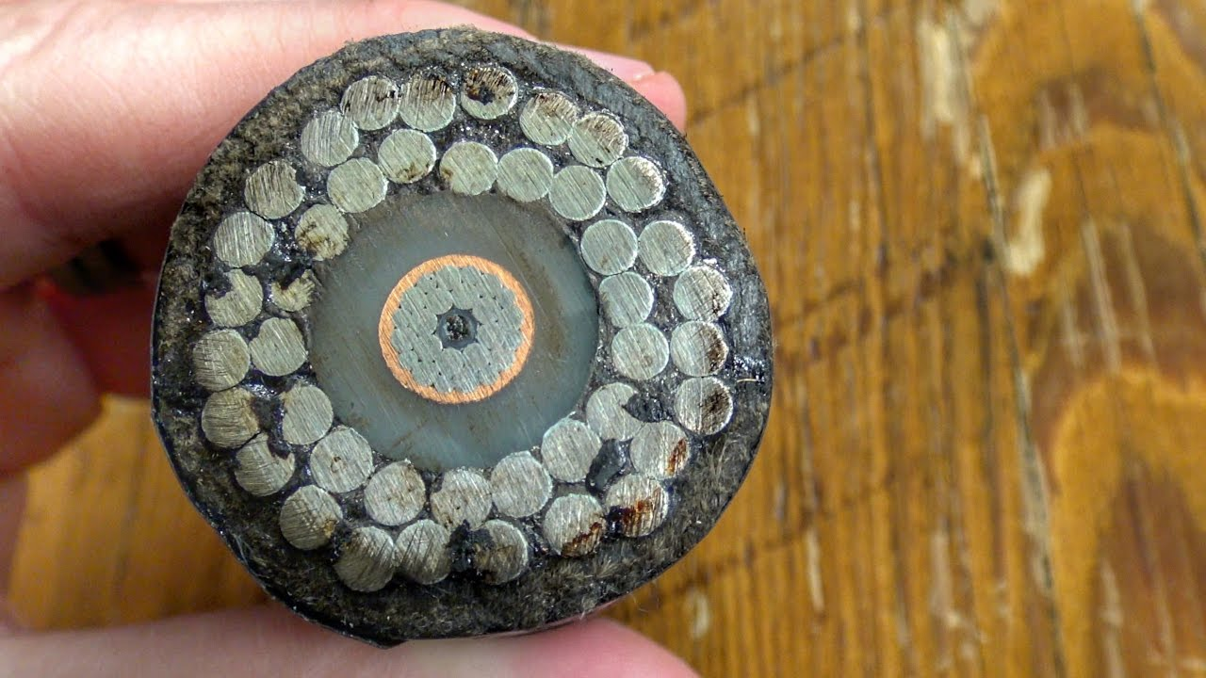
The Internet is Physical

Slide 20
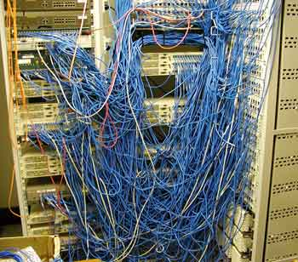
The Internet is Physical

Slide 21
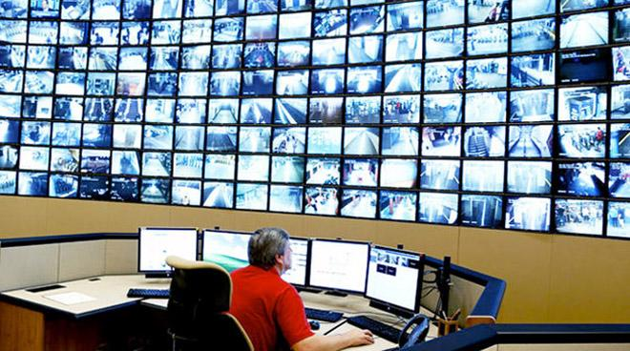
When Will It Fail?
Notes:
"1984? Yeah right, man. That's a typo. Orwell is here now. He's livin' large" - Cereal Killer

Slide 22
Internet Shutdown
accessnow.org/keepiton/
Notes:
52 in 2018

Slide 23
Internet Freedom
How We Will Save It

Slide 24
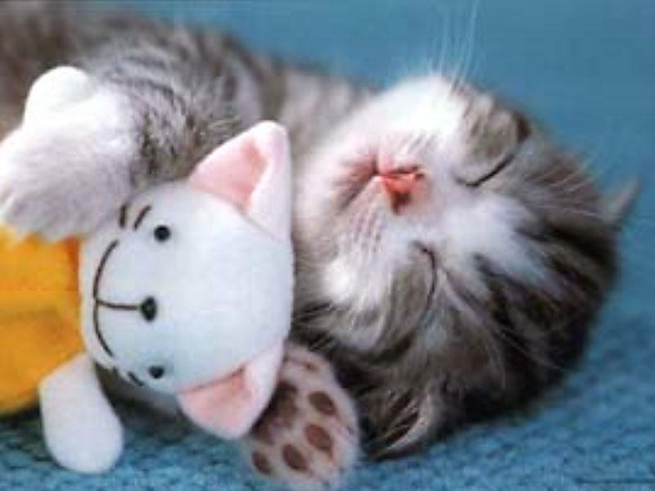
Censorship Circumvention

Slide 25
Censorship Circumvention
X ✔

Slide 26
Censorship Circumvention
X ✔

Slide 27
Censorship Circumvention
✔ ✔

Slide 28
Further Reading
Operator Foundation - Shapeshifter
Pluggable Transports Specification v2.0
Defeating Internet Censorship with Dust, the Polymorphic Protocol Engine
Circumventing Network Filtering with Polymorphic Protocol Shapeshifting

Slide 29
What about shutdowns?

Slide 30
EDEN - Peer-to-peer texting
Arduino with Cortex M4F processor
LoRa packetized radio communication
900 MHz, 20 dBm, 2 km range
27 kbps

Slide 31
EDEN - Voice
RFM69HCW packetized radio
900 MHz, 20 dBm, 0.5 km range
Codec2 voice compression
Mode 700C gives 0.5 s of audio per packet
Codec2 Arduino package
Any node can be a repeater

Slide 32
EDEN - Satellite
Iridium satellite network
Bridged to the mobile text network
Meshes with peer-to-peer texting
Works everywhere in the world

Slide 33
EDEN - Differentiators
Long range, low bandwidth
Satellite link
Repeaters
Emergency communication focus
Urban deployment focus

Slide 34
Support Internet Freedom
OperatorFoundation.org
Yes, we accept Bitcoin donations.

Slide 35
Bonus Slides

Slide 36
Operator Projects
Moonbounce
iOS Swift API for Shapeshifter
iOS Network Extension for Shapeshifter
OpenVPN transports
Postcard

